Slide 1

DDSAnalytics Talent Management Analysis
Case Study 2
Jaren Shead

Slide 2
Agenda/Overview
Initial Data Analysis/Cleaning
Exploratory Data Analysis
Identifying Key Factors (Attrition)
Advanced Analysis/Prediction and Attrition Model
Identifying Key Factors (MonthlyIncome)
Advanced Analysis/Prediction and MonthlyIncome Model

Slide 3
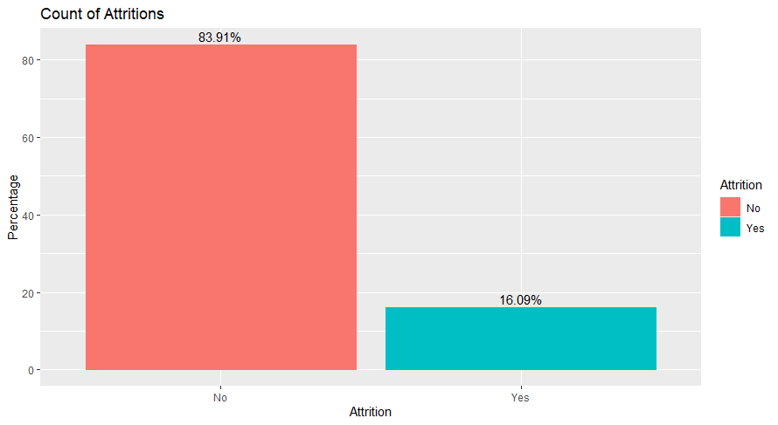
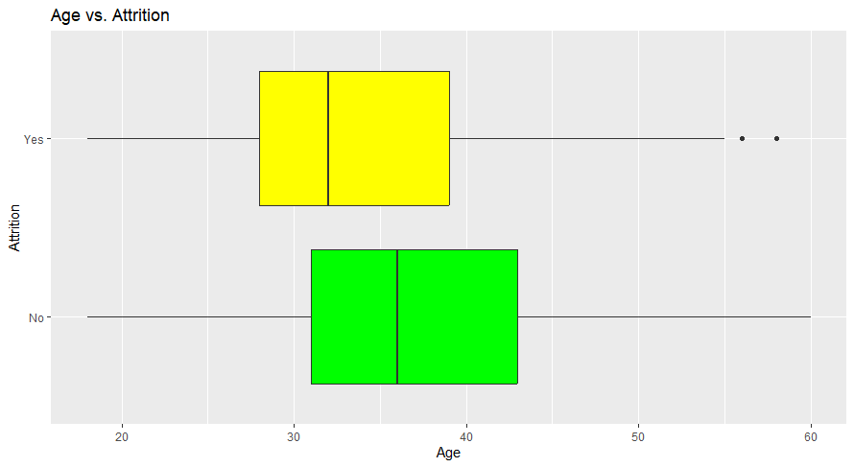
Initial Data Analysis/EDA
16% Attrition
Median age of Attrition is lower than the median age of those that were not included in Attition
Notes:
First I did a visualization of attrition within the data and found approximately 16% of our data points to be attrition.
After addressing any missing values in the data, I started investigating possible relationships within the data.
Here you can se that the median Age where attrition is yes is about 5 years lower and when attrition equals no.
This suggest that those who leave the company tend to be a bit younger.
This also indicates a possible relationship between Age and attrition.

Slide 4
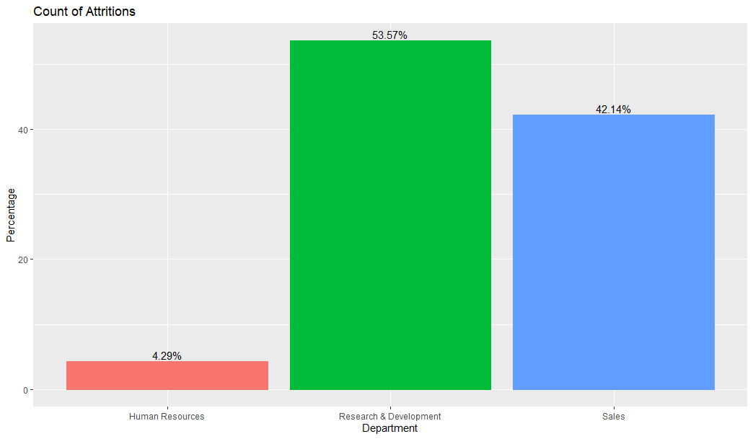
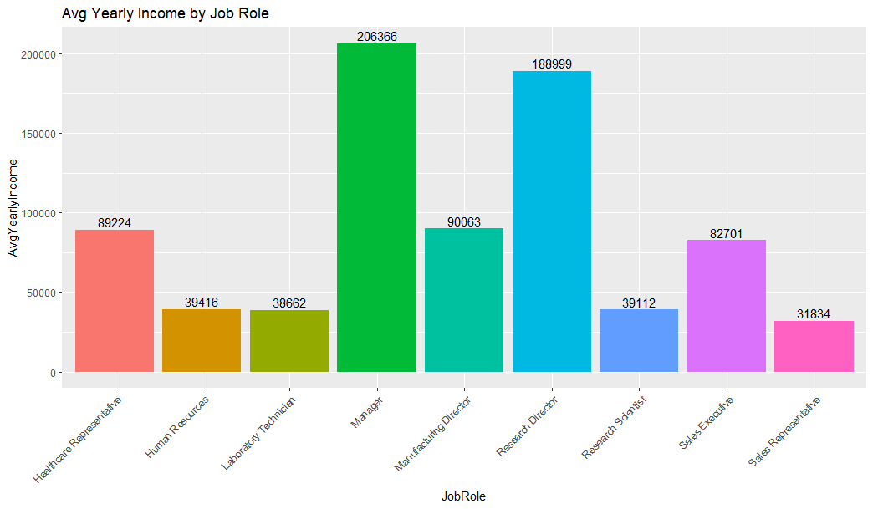
Initial Data Analysis/EDA
The R&D Department accounts for over 50% of company Attrition
Yearly salary calculated by MonthlyIncome * 12
Notes:
Next I investingated Department and JobRole as I believed they could play an impotatnt role in attrition
As we can see, The R&D Department accounts for over 50% of company Attrition
And Managers and Research Directors gets paid a yearly salary much higher than their peers in other job roles

Slide 5
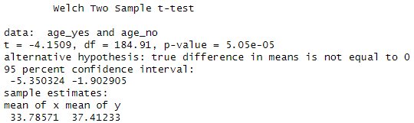
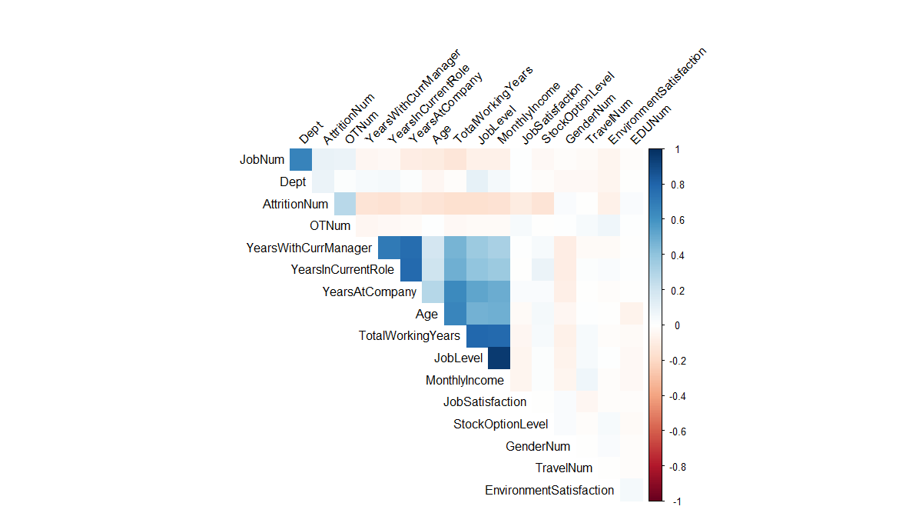
Identifying Key Factors(Attrition)
T-test
P value of 5.05e-05 indicates a strong significance.
Correlation Matrix
Highest Correlation to Attrition:
Job Level
TotalWorkingYears
Overtime(Not pictured)
Notes:
I started by Conducting a two samples t test on Age since we saw in the box plots earlier that there may some trend there. After finding a very low p value I now feel that Age is a significant variable in the result of Attrition.
Next, I created a correlation matrix by converting categorical variables to numeric and using those and my numerical variables to see their correlation to Attrition
Here is a Heat map showing those relationships
The higher these numbers are, the more correlation they have to the variable opposite them.
After conducting these tests, I found TotalWorkingYears, JobLevel, and Overtime to be the variables with the highest correlation to Attrition

Slide 6
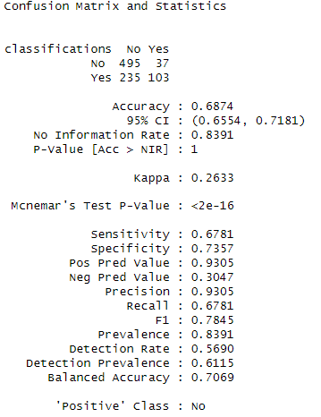
Advanced Analysis/Prediction and Attrition Model
Validation Test
Accuracy: 68.7%
Sensitivity: 67.81%
Specificity: 73.5%
Notes:
After finding the variables I belived to be most associated with attrition, I decided to a train split validation test using the undersampling method.
I chose to use undersampling due to the Disproportionate volume of attrition relative to our entire data set.
After conducting this test on our original data and achieving an accuracy I believed to be optimal for our purposes, I went forward and created a knn model
Using the undersampled data set that I would then use to predict and classify the attrition of our test data

Slide 7
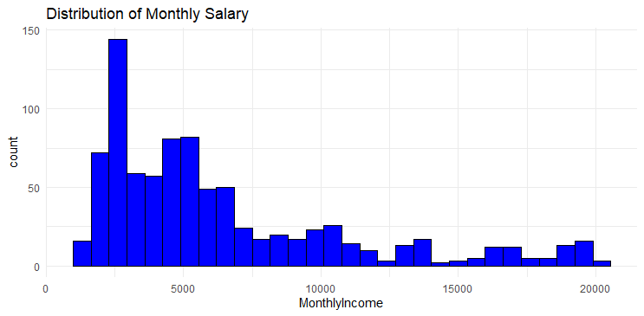
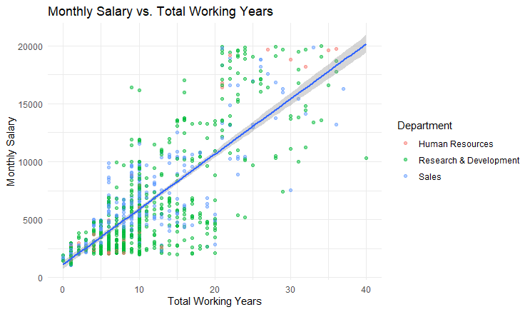
EDA/ Identifying Key Factors (MonthlyIncome)
Most employees make less than 5 thousand per month
Positive correlation between Monthly Income and Total Working Years?
R&D Overload
Notes:
I started my investigation by plotting monthly income to gain better insight on its distribution within our data
I found that most employees make less than 5 thousand per month
I also found a positive correlation between Total working years and monthly income
As well as a pretty big disparity in the distribution of employees throughout departments. The charts seems to be dominated mostly by the Research and Deveelopment Depantment.

Slide 8
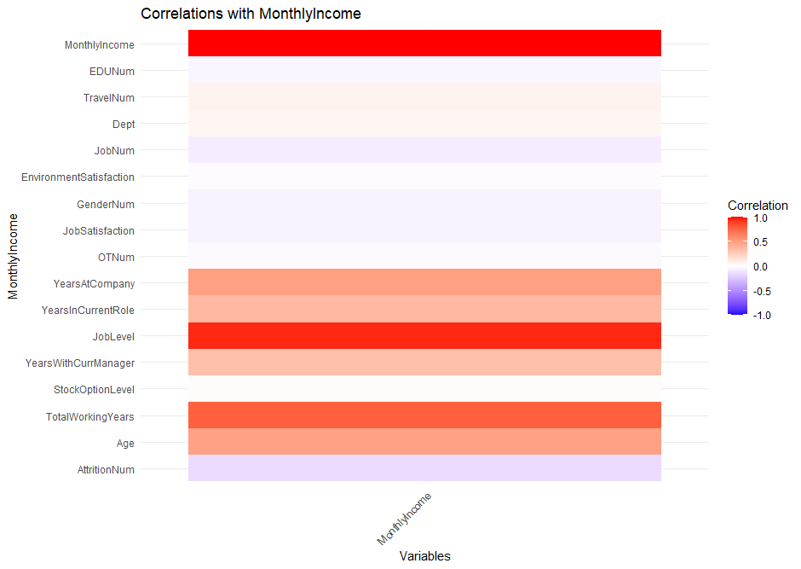
Identifying Key Factors (MonthlyIncome)
Correlation Matrix
Highest correlation to MonthlyIncome:
JobLevel
Attrition
TotalWorkingYears
Notes:
Here, I created a correlation matrix again to investigate the relationship of my variables.
More specifically, how they relate to Monthly Income
Here is a Chart Showing their relationship
I found the best variables here to be JobLevel, Attrition, and TotalWorkingYears

Slide 9
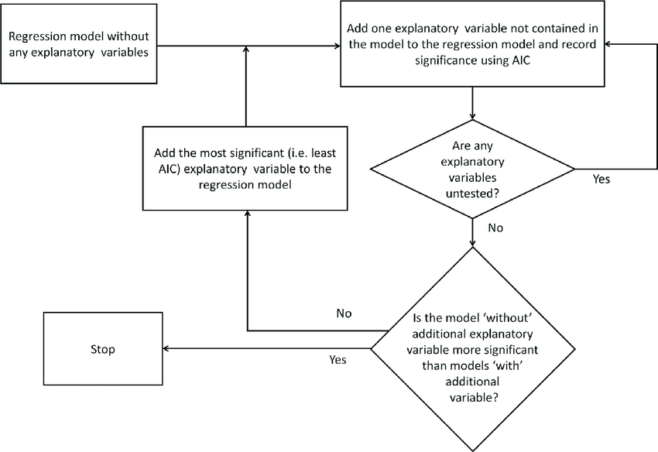
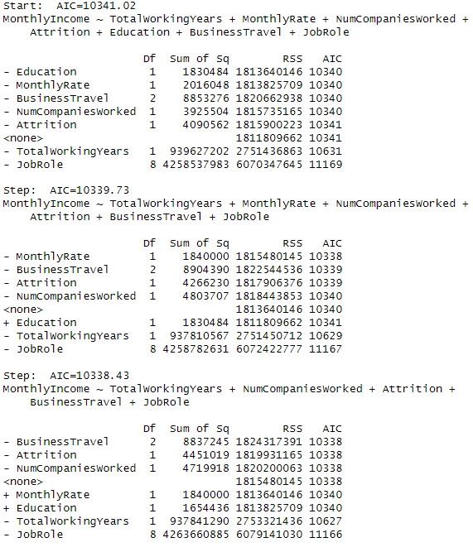
Advanced Analysis/Prediction and MothlyIncome Model
Snippet from the Stepwise Feature Selection
Here the selection process adds and removes different features to find the most optimal combination for predicting MonthlyIncome.
A lower AIC(Akaike Information Criterion), means a higher quality model.
Final validation RMSE: 1622.12
Notes:
Finally, to create a model that will accurate predict MonthlyIncome, I used linear regression along with stepwise feature selection to fine tune my predictions.
Stepwise feature selection is a technique used to select the most relevant features for building a predictive model.
The primary goal is to improve model performance by reducing overfitting, enhancing interpretability, and potentially increasing efficiency by using fewer features.
When building my model, I first used train split validation with the original data set to test my model accuracy so the I could get the lowest RMSe possible.
For those who don’t know, RMSE stands for Root Mean Squared Error. It is a commonly used metric to evaluate the accuracy of a predictive model. RMSE measures the average error between predicted values and observed values. It provides a measure of how much predictions from a model differ from the actual values, with a focus on the variance of errors.
After testing, I received an RMSE of 1622.12, which I deemed acceptable given the circumstances.
After confirming the model can regularly produce an acceptable RMSE, I applied the it to my test data set and predicted Monthly Income of the employees.

Slide 10
Thank You!
Contact: jshead@smu.edu
Questions?

